Slide 2



Forms Administration & Design
This presentation is CONFIDENTIAL and property of Softdocs, Inc. It is to be used only for the purpose intended. Any unauthorized use is strictly prohibited. © 2017 Softdocs, Inc.

Slide 3
Agenda
Central Administration
Form Groups
Form Administration
Search, Delete, and Create Forms
General Settings
Files
Inputs
Preview
Connect
Fillable PDFs
CSP Violation Reports

Slide 4
Central Administration

Slide 5
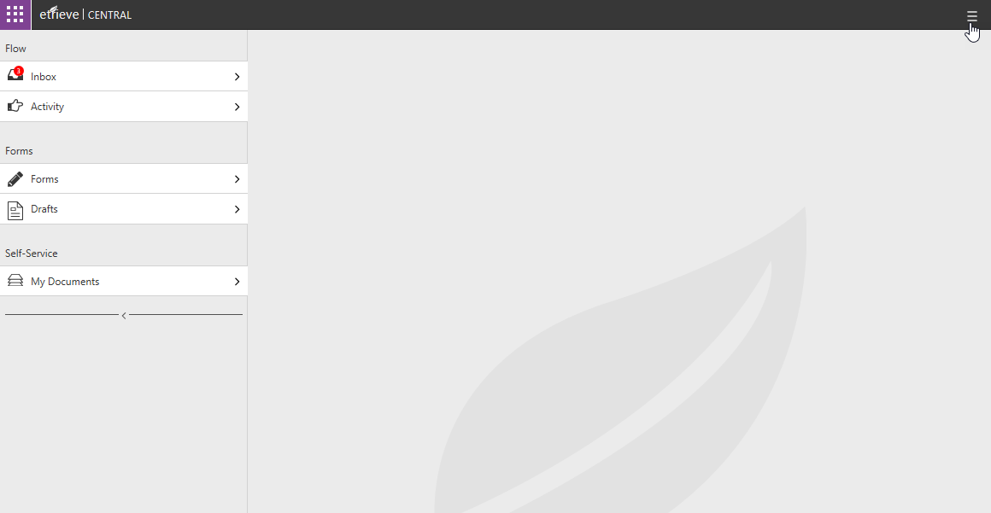
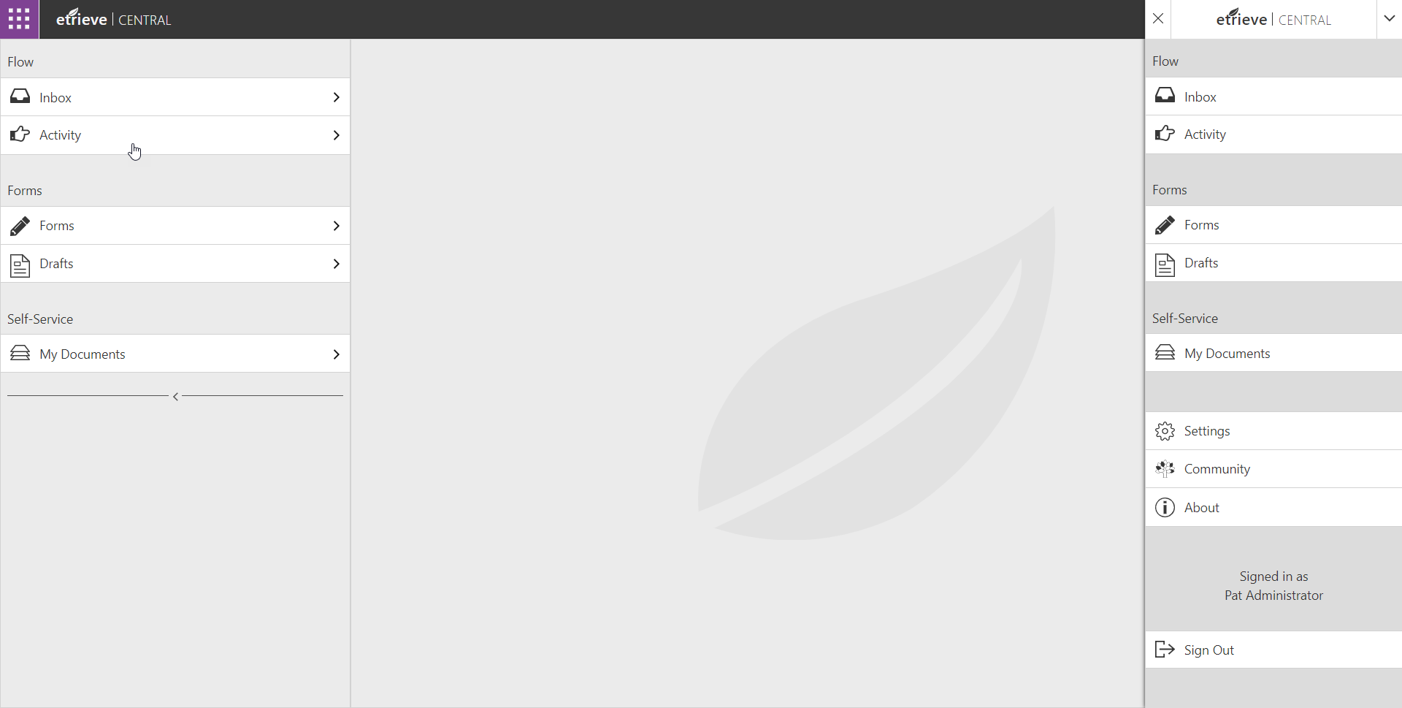
Accessing Administration Tools
Administration accessed by clicking on Settings

Slide 6
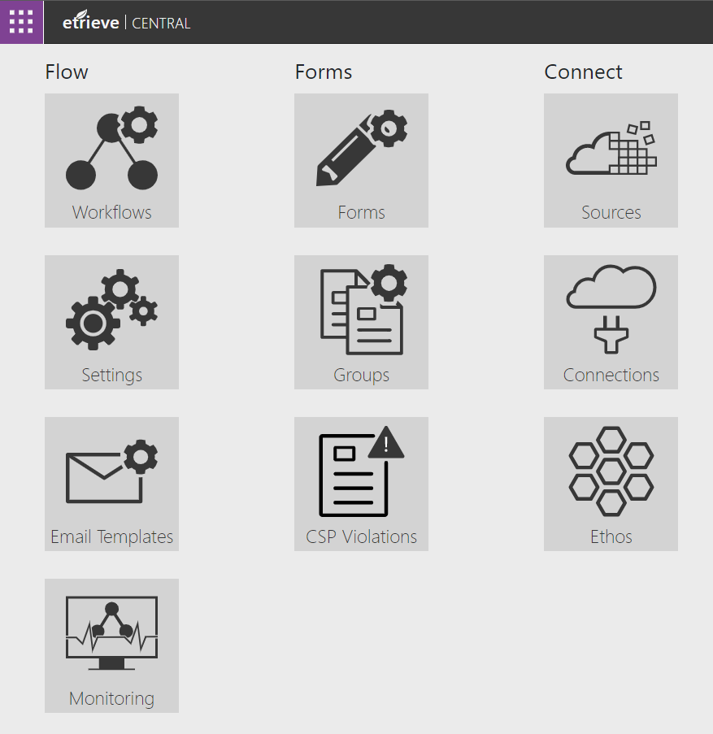
Form & Group Administration Tools

Slide 7
Form Groups

Slide 8
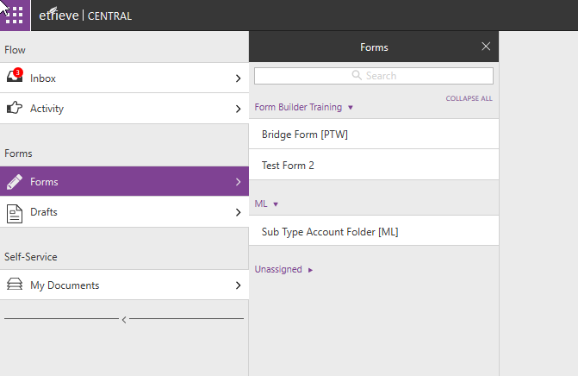
Form Groups
Form Groups Organize the Form Library in Central
Groups can expand and collapse the list of forms
Forms not assigned to a Group will display under Unassigned

Slide 9
Form Groups
Form Groups are optional
Default will be “Unassigned”
A Form can only be assigned to a single Form Group
Form Group names can be edited
Form Groups can be deleted
All associated Forms must be removed first
Security is based on Forms – Not Form Groups

Slide 10
Form Group Administration Tools

Slide 11
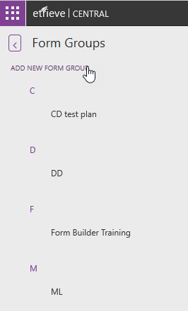
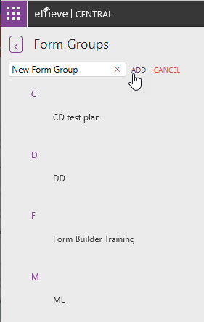
Adding a New Form Group
Add a new Form Group by clicking on “Add New Form Group” button

Slide 12
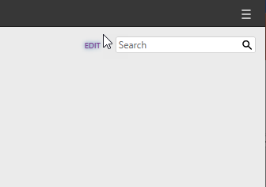
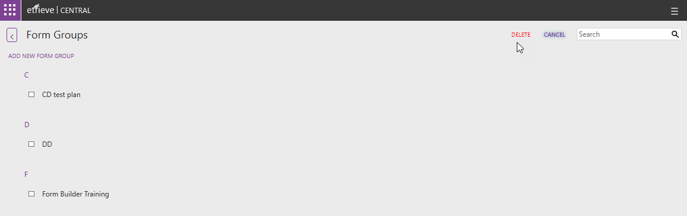
Deleting a Form Group
Click “Edit” then check the box next to the checkbox next to the Form Group
Click “Delete” to remove the Form Group
1
3
2

Slide 13
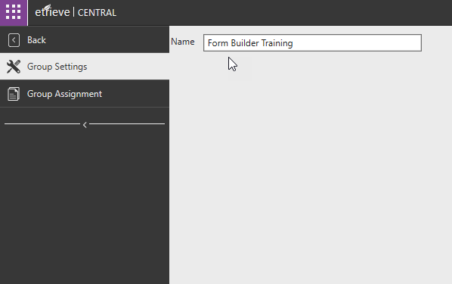
Form Group Settings
The name of the Group can be edited on the Group Settings tab
Changes save automatically

Slide 14
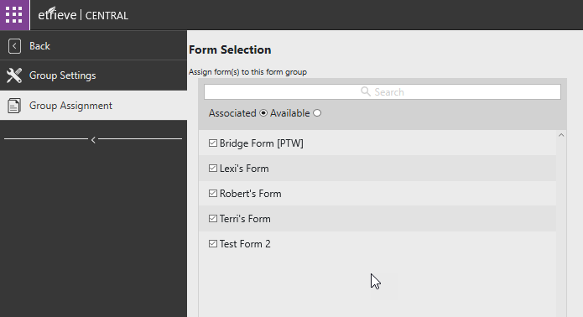
Form Group Settings
The Group Assignment tab will display any forms that are associated with the Group
Selecting the Available option will display all Forms that are available to associate to the Group

Slide 15
Form Administration

Slide 16
Forms Administration

Slide 17
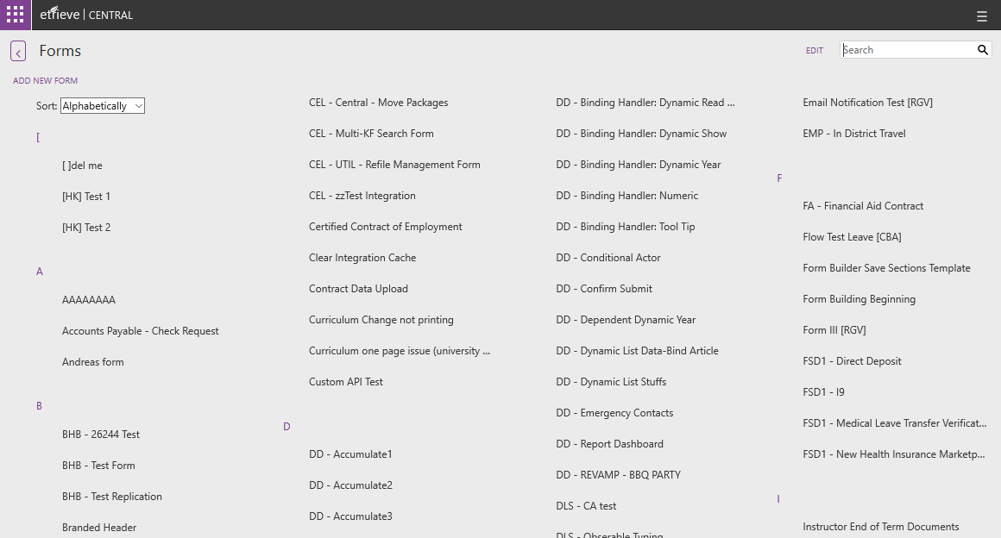
Forms List & Adding a New Form
A new Form can be created by clicking “Add New Form”
The Forms List can be sorted Alphabetically or By Form Group using the Sort dropdown
The list can be filtered by entering text into the Search field

Slide 18
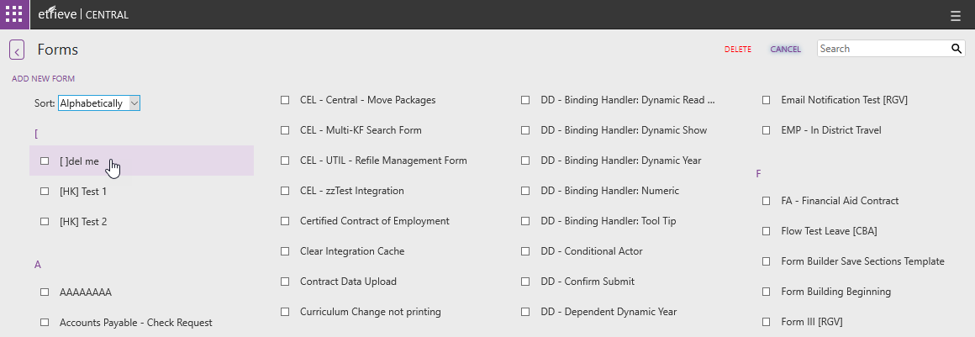
Deleting a Form
Click “Edit” then check the box next to the checkbox next to the Form
Click “Delete” to remove the Form
1
3
2

Slide 19
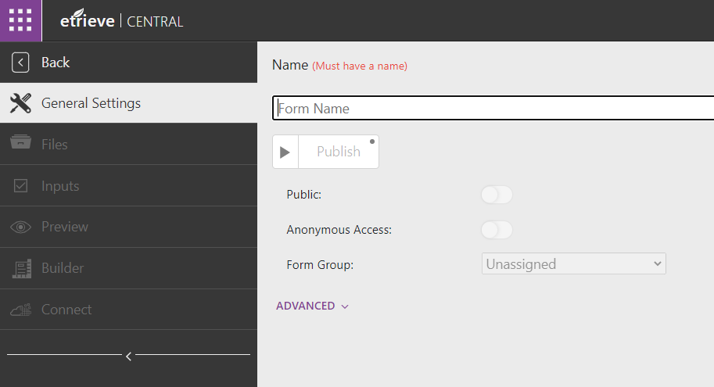
Creating a New Form
The General Settings is where the Form’s Name is entered. All other form options are disabled until the form is named.
Enter a name for the new Form and hit enter or tab to leave the field. The form will be created and the other functions will become available.

Slide 20
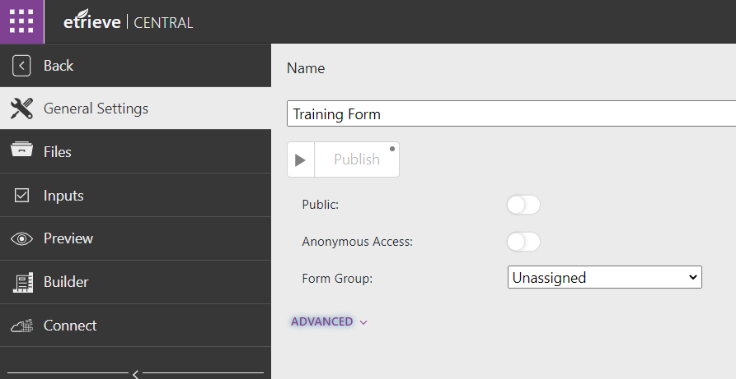
Creating a New Form
Assign the Form to a Form Group by selecting a Group from the Form Group dropdown.

Slide 21
General Settings
The Publish button will make the Form available in the Forms library for users with access privileges to the Form.
Published forms cannot be edited.

Slide 22
General Settings
The Public toggle will make the Form available to ALL users.
This is only used for 3rd Party accessible forms
Anonymous Access will allow the form to be accessible to non-authenticated users.
Turning this on will provide a deep link to access the form.

Slide 23
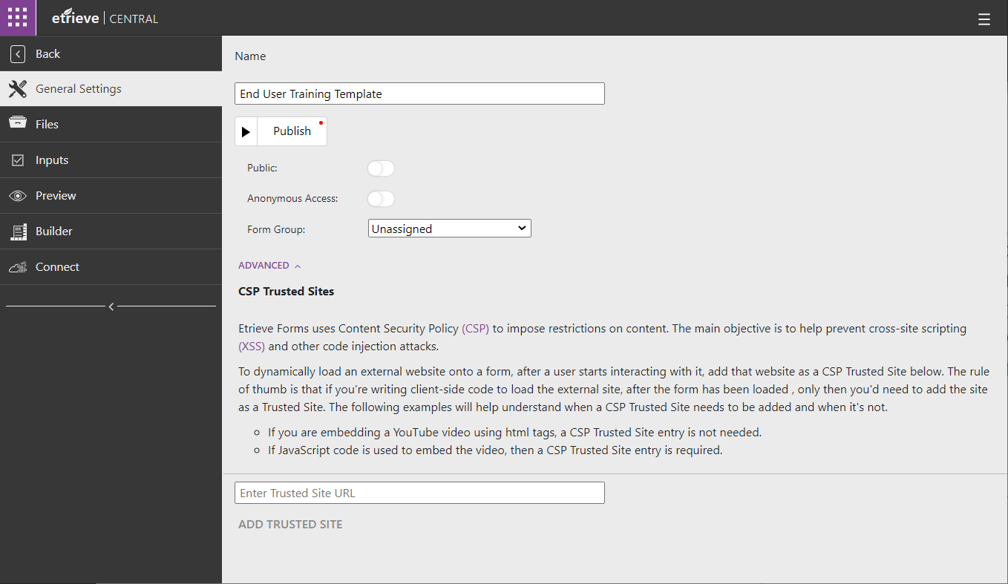
General Settings
If the form is referencing a 3rd party JavaScript source, that site will need to be added as a trusted site

Slide 24
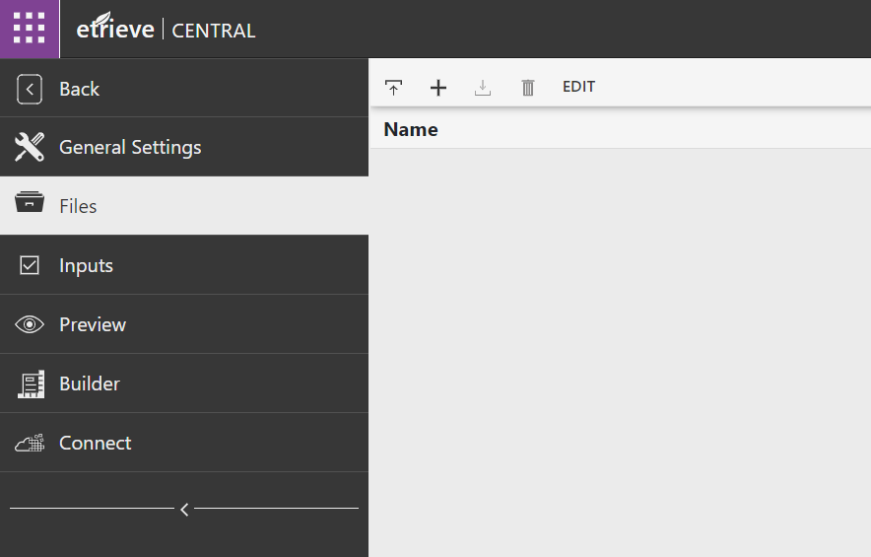
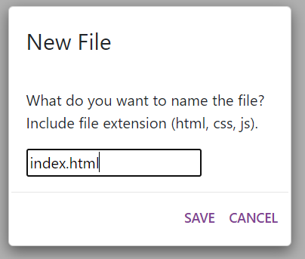
Files
The Files tab allows access to the Form’s code files.
Upload files to the form. Files can also be dragged and dropped to upload
Create files.

Slide 25
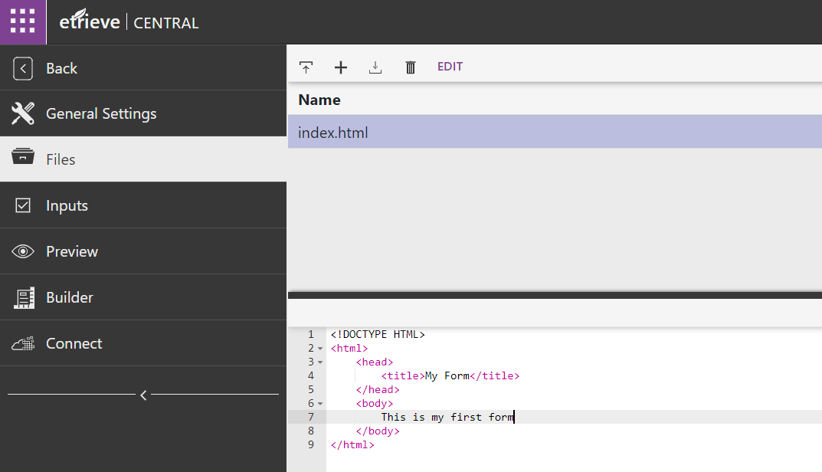

Editing Files
Click the file to open the code for editing
All changes in the text editor will auto save
Download the selected file

Slide 26
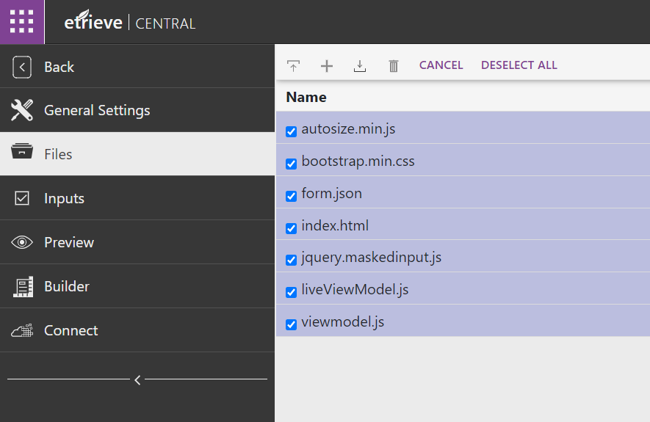


Downloading the Form’s Files
Downloading multiple files will zip the files together
Edit to enable the editing tool
Select All the form files
Download the form files

Slide 27
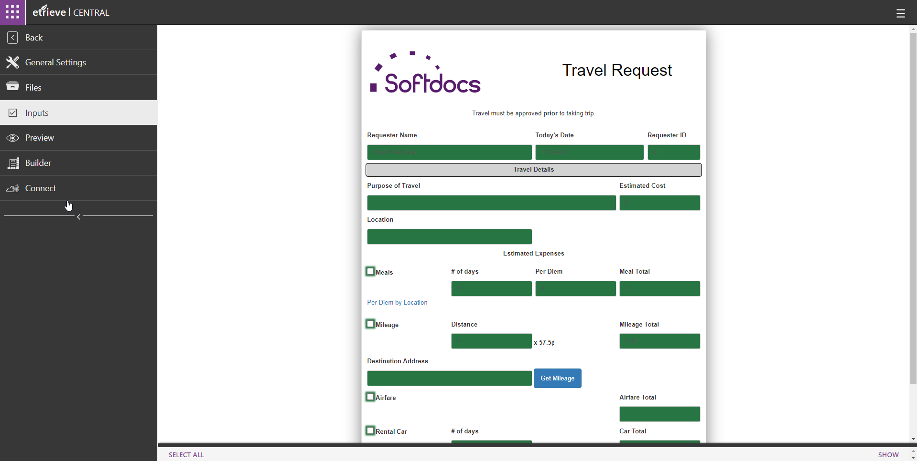
Inputs
Selected Form Fields are used for:
Workflow Package Names
Workflow Navigation Rules
Workflow Integrations
Broadcast Actor
Conditional Actor
Data Export
Exporting to Content
Fields that have been selected as Inputs will display in green

Slide 28
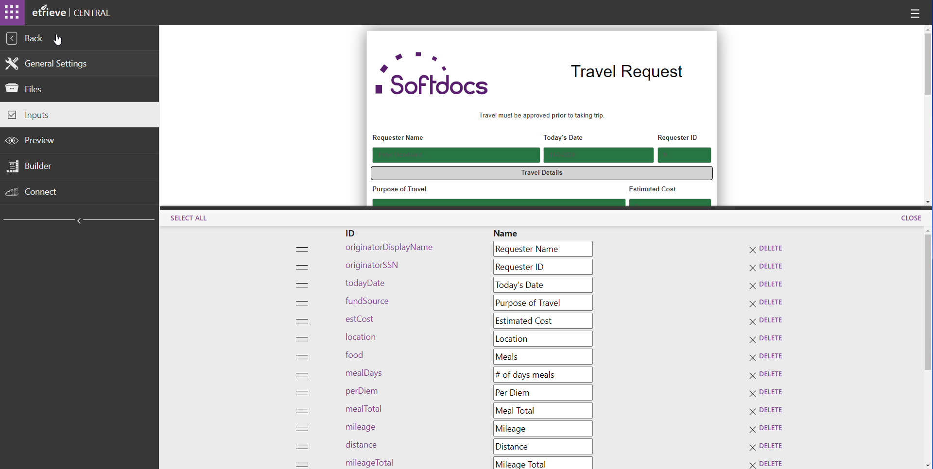
Inputs
Click “Show” to view the IDs & Names of the selected input fields
Selected inputs can be reordered from this menu

Slide 29
Inputs & Workflow Exports
Input Field order defines the order Fields will be listed in the import file when the Form is exported at the end of a Workflow
First 4 Fields will always be:
Image Path
Document Type (defined in Workflow End Step Export)
Workflow Package ID
Document Date

Slide 30
Inputs & Workflow Exports
First Field listed on Inputs tab will be Field 5
To determine a Field’s position in the export file, count starting from 5 in the Input Field list
Use the Field position to correctly map Fields in the Content Import associated with the Form

Slide 31
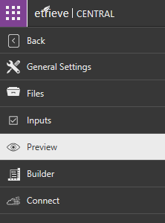
Preview
The Preview tab will show the Form in its current state to allow testing of Form functionality.
Always check if form fields are “sent to server”

Slide 32
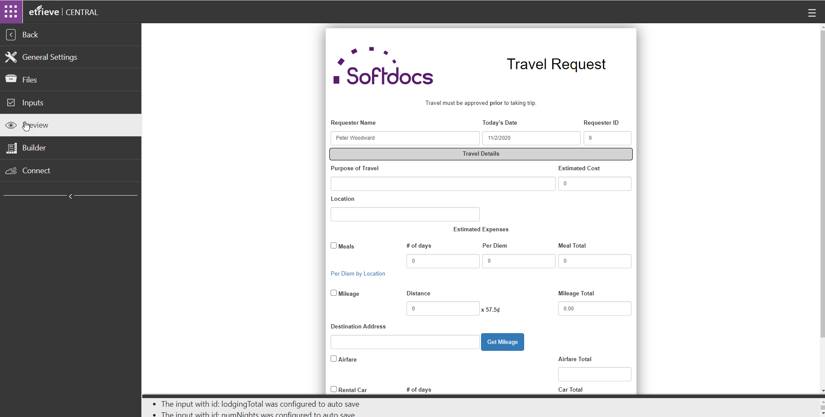
Preview
On the Preview Tab a Form will display as a User would see the Form in the Forms Library
JavaScript Code and Integrations can be tested on this Screen to ensure the Form is functioning correctly.

Slide 33
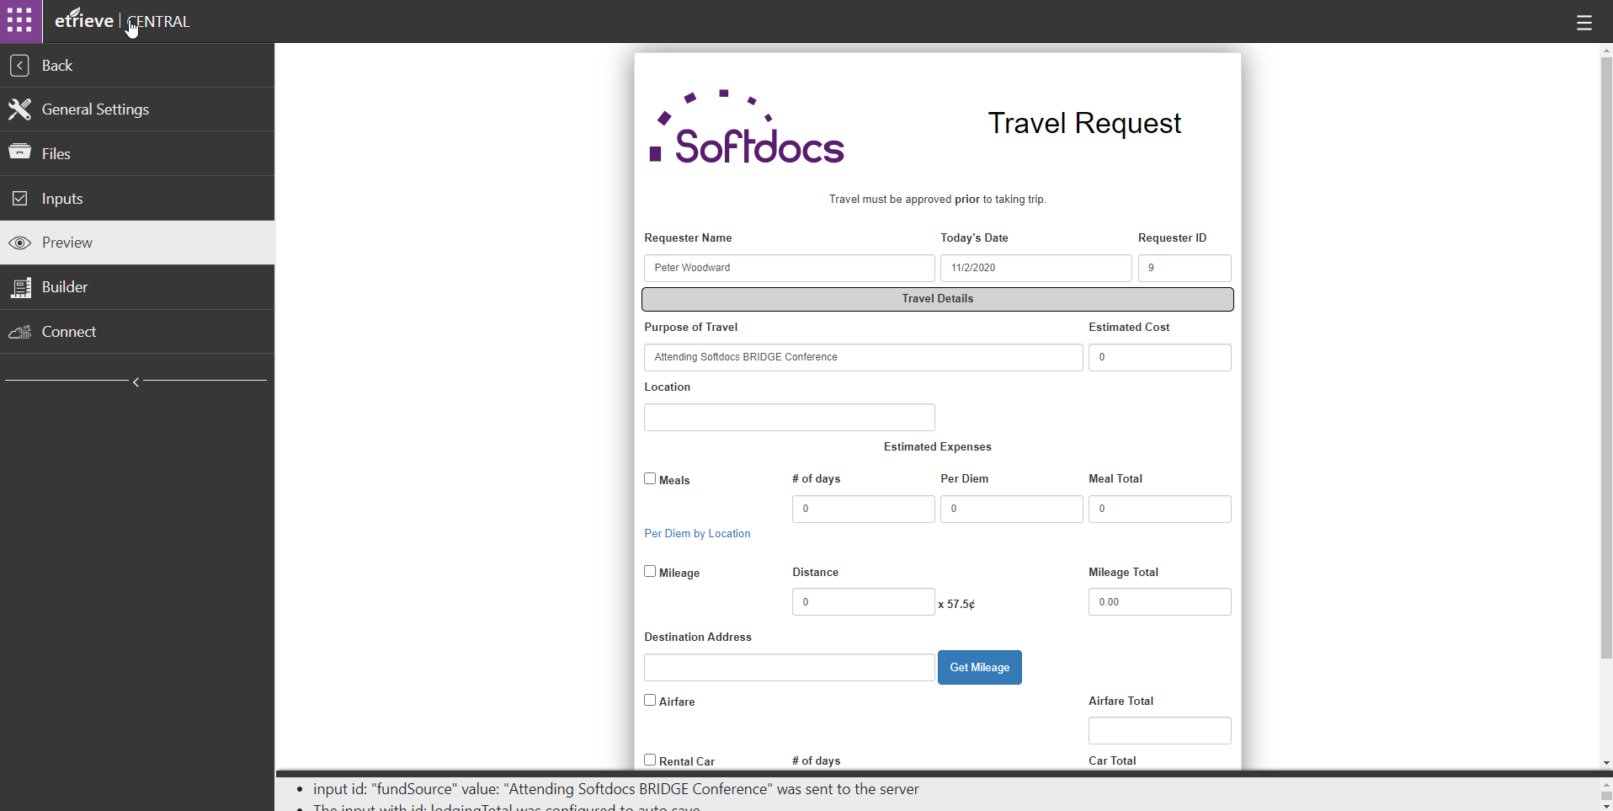
Preview
As values are entered on the form, the Form Console at the bottom of the screen will show the values sent to the database for each input

Slide 34
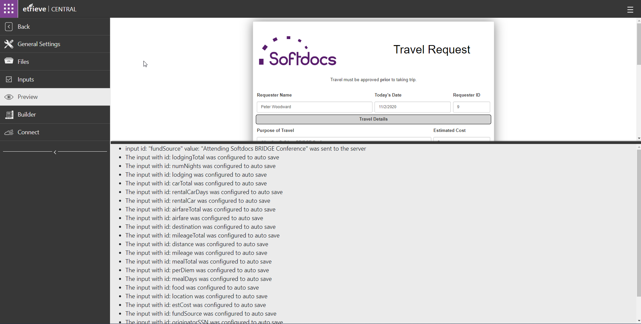
Preview
The Form Console can be expanded by dragging the black bar at the bottom of the screen up

Slide 35
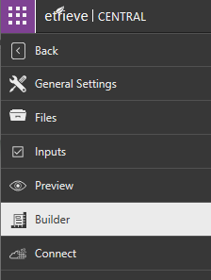
Builder
The Builder tab accesses the Form Builder

Slide 36
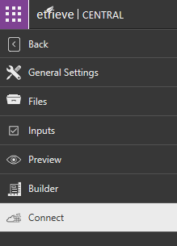
Connect
The Connect tab is used to associate the Form to Integration Data Sources.

Slide 37
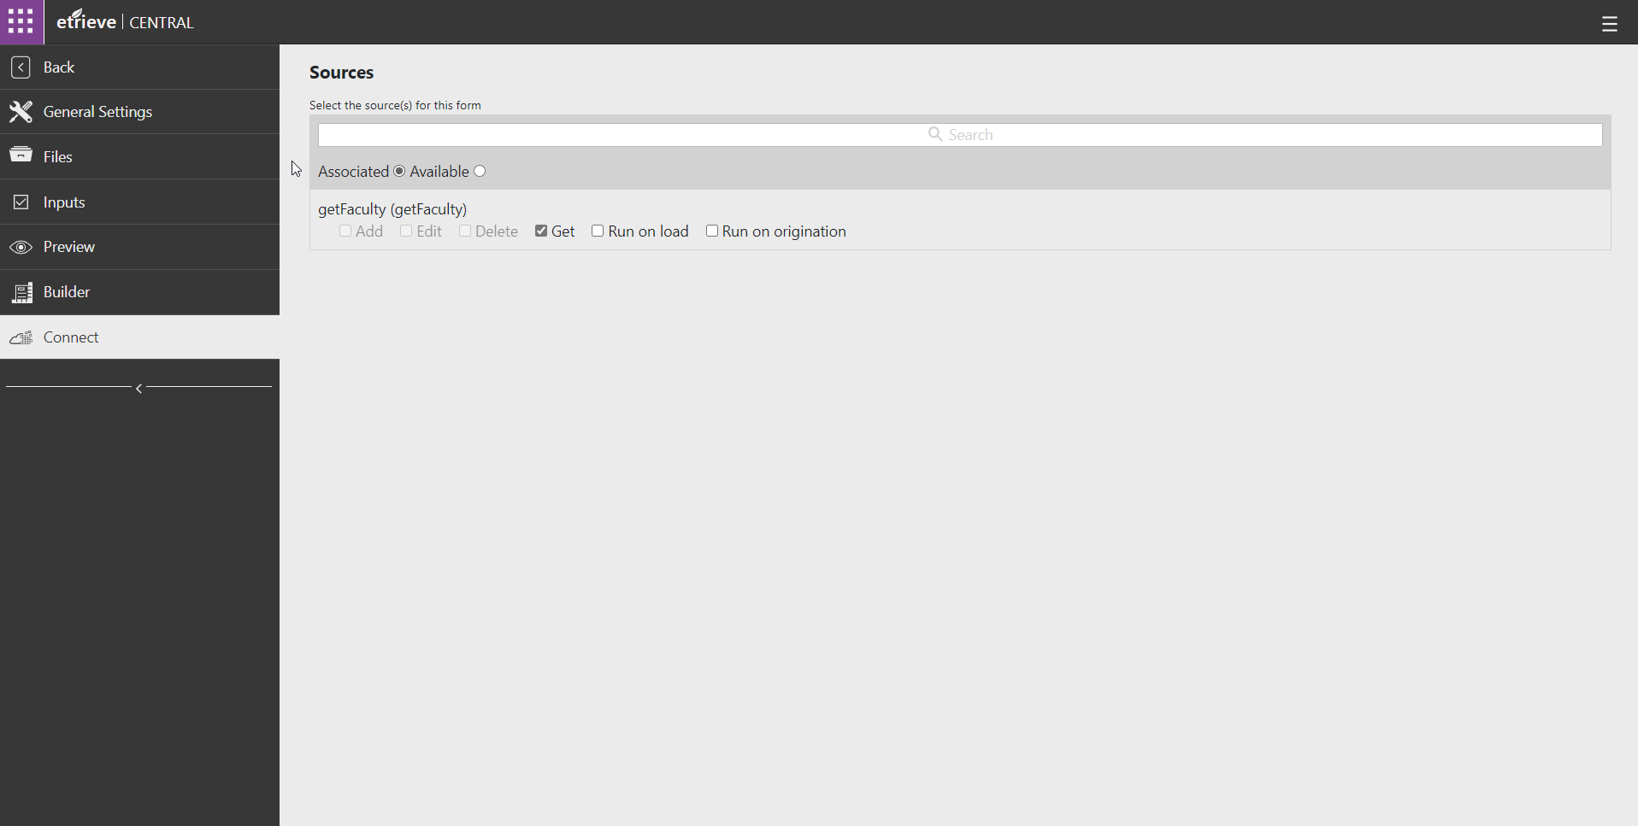
Connect
The Connect Tab will show Integration Sources associated with the Form (and their actions) by default

Slide 38
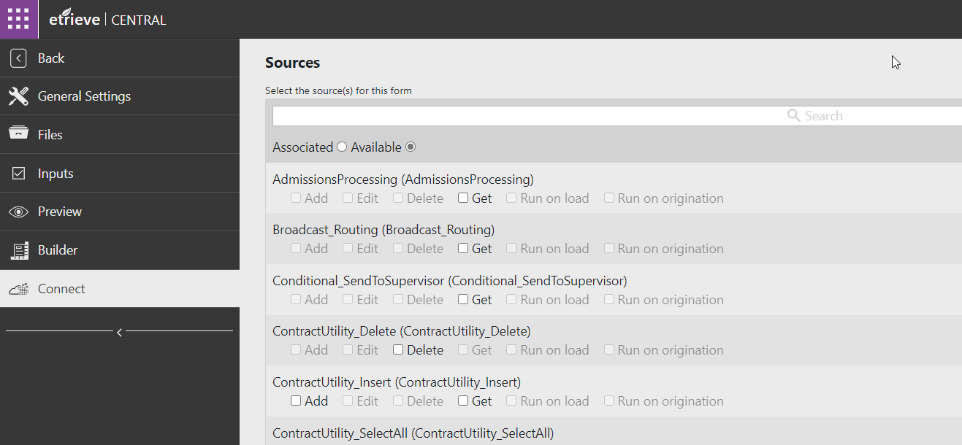
Connect
Click the Available Radio Button to see a list of all available Integration Sources

Slide 39
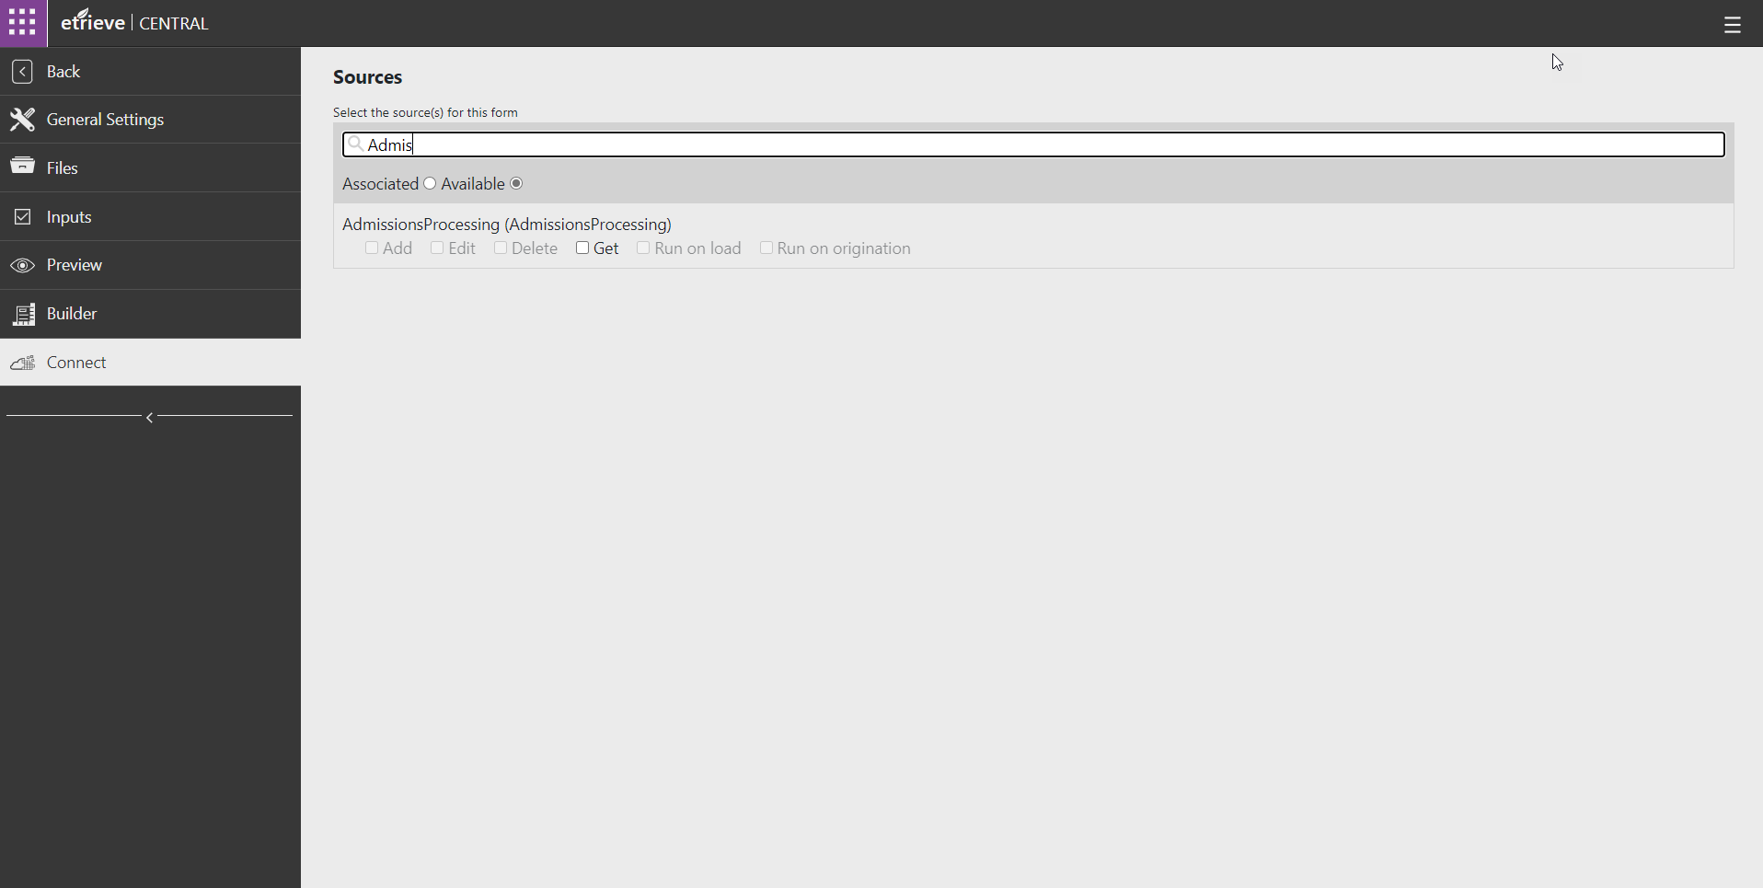
Connect
1
2
3
The list of Sources can be filtered by entering text in the Search Field.
Source Name
To associate a Source to a Form, click the checkbox for the Action the Source executes

Slide 40
Connect
To disassociate a Source, from a Form, uncheck the box for the Action the Source executes

Slide 41
Fillable PDFs

Slide 42
Fillable PDFs
PDFs that already have input fields configured can be uploaded as an Etrieve Form.
Fillable PDFs cannot display:
Radio Buttons
Select Drop-downs
The Viewmodel.js can be utilized to manipulate PDF input fields for validation
Fillable PDFs are not accessible in Etrieve

Slide 43
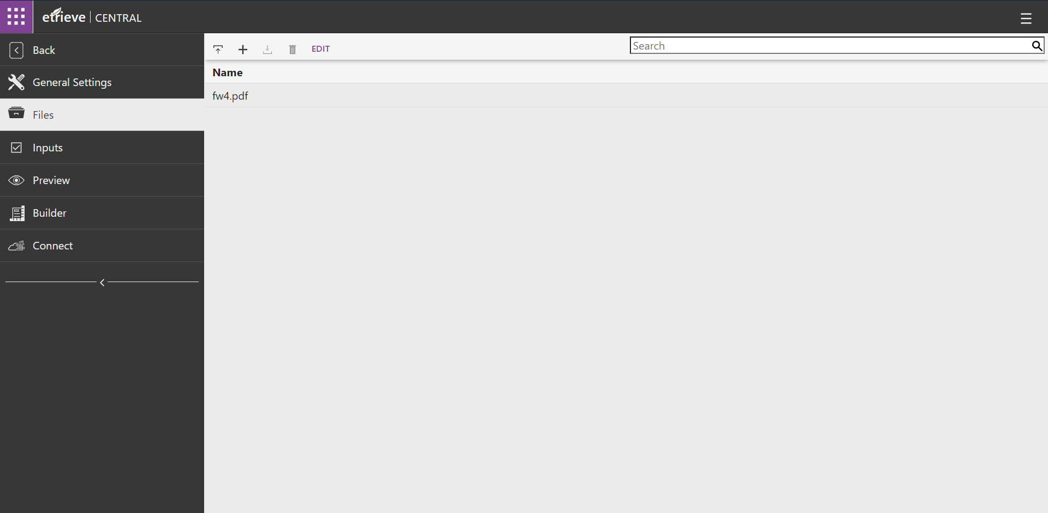
Fillable PDFs
Load the fillable PDF into the Files tab

Slide 44
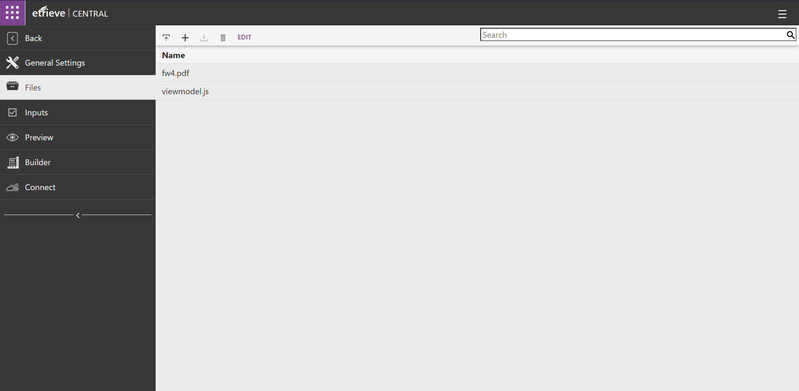
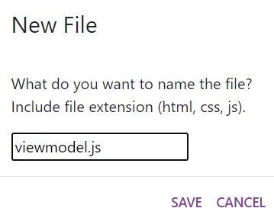
Fillable PDFs
To add a viewmodel.js to the form, click “+” and type “viewmodel.js” and press “SAVE”
Adding a viewmodel.js to the PDF will allow you to perform form life cycle JavaScript functions to your fillable PDF

Slide 45
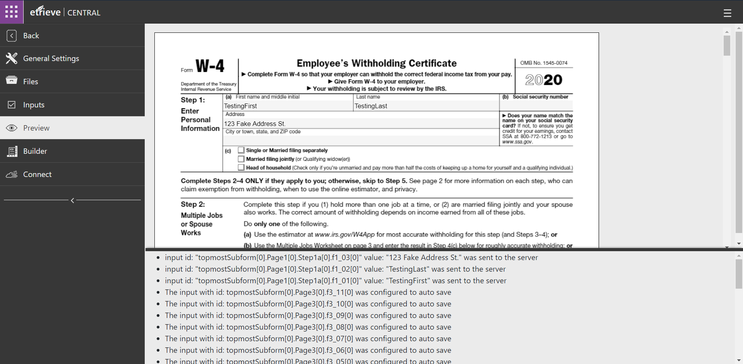
Fillable PDFs
Preview & Test the fillable PDF from the Preview tab
Verify data being entered in the PDF is being sent to the server successfully

Slide 46
CSP Violation Reports

Slide 47
CSP Violation Reports
Reports any form’s CSP violations (Content Security Policy)
Will report if a form is referencing a JavaScript library from a 3rd party site

Slide 48
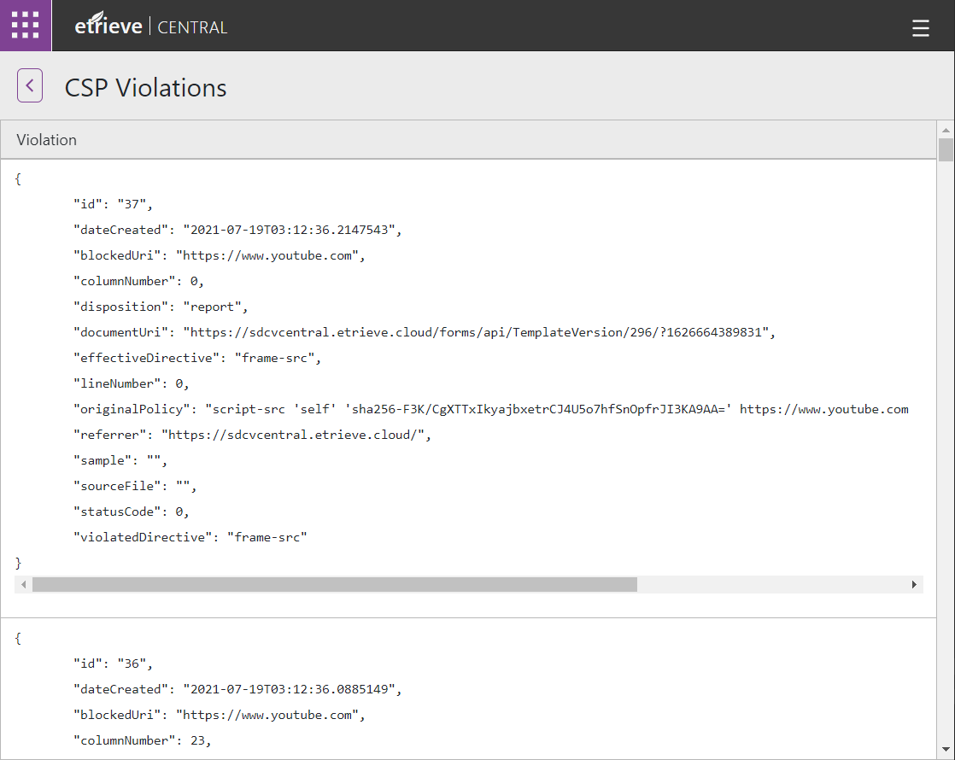
CSP Violation Reports
Report shows Form’s ID and the specified 3rd party JavaScript blocked URLs
By default, 3rd party URLs are not blocked in Etrieve but will always report.

